Slide 1
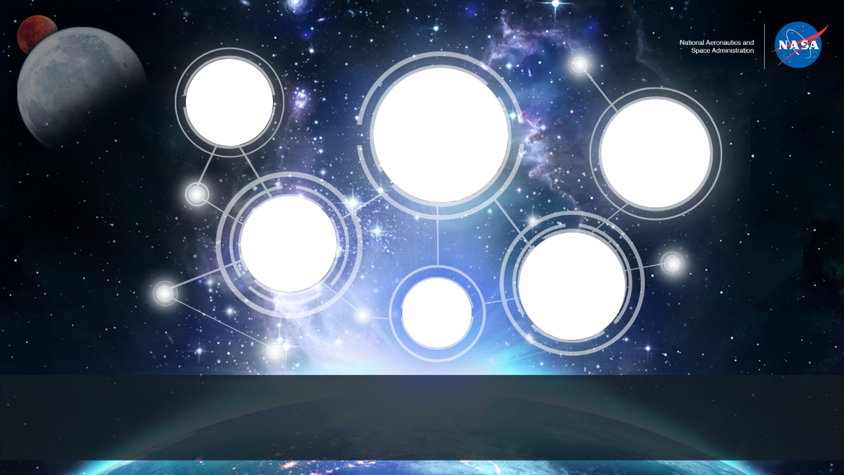
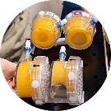
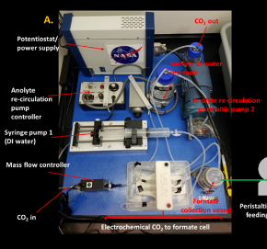
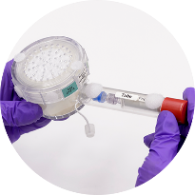
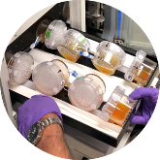
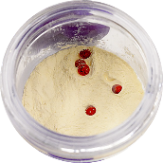
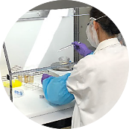
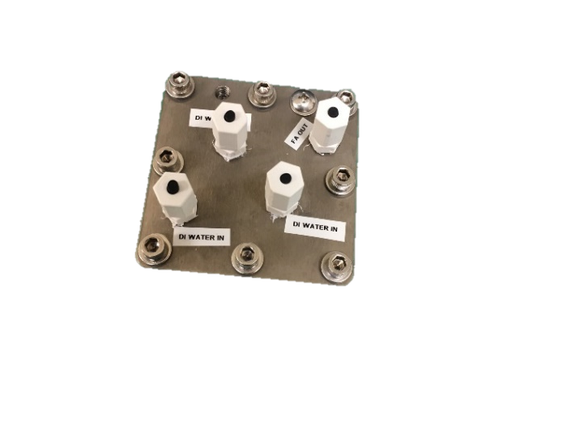
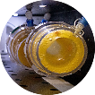
Space Technology Mission Directorate
Game Changing Development Program —Synthetic Biology (SynBio)
Frances Donovan| Synthetic Biology Project Monthly Status Report | 04.2021

Slide 2
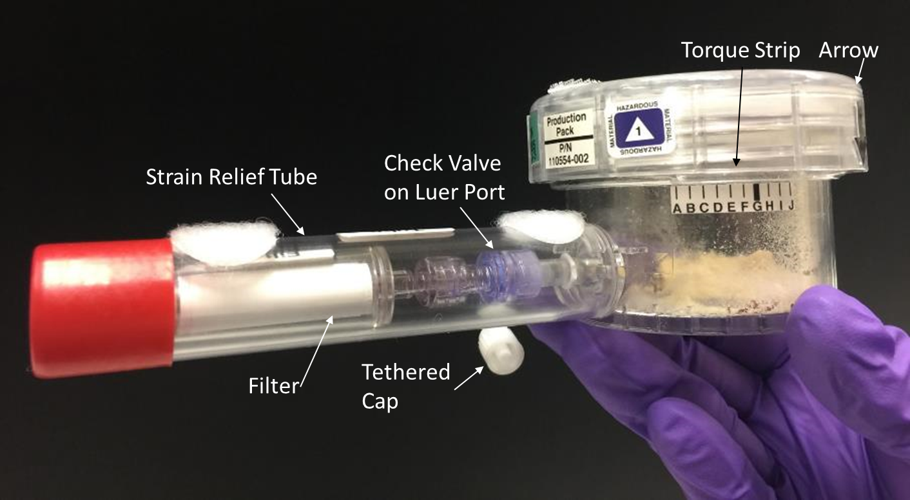
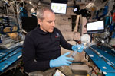
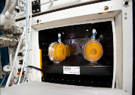
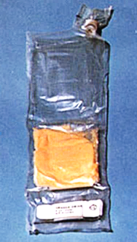
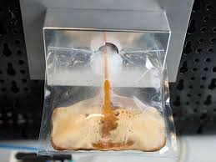

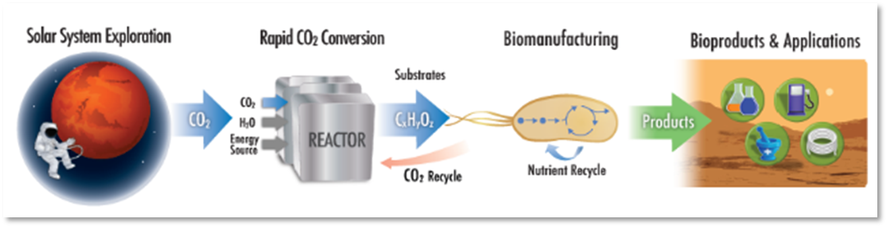
Project Overview
Technology Product Capability
Develop and demonstrate an on-demand nutrient production system for long-duration missions to mitigate demonstrated nutrient degradation in stored foods. Develop an evolvable platform for future surface missions – capable of producing other compounds (e.g., Medicines) requiring minimal resources. Perform an ISS time-course hydration, incubation, freezing and return for analysis over 5 year period.
Develop and demonstrate a prototype system that enables microbial manufacturing via abiotic CO₂ conversion to products that drive biomanufacturing for future long-duration missions.
Technical Capabilities
Reduced gravity compatible bioreactor development
Long-duration ambient storage of microorganisms
Methods for ensuring quality and safety of biomanufactured products
Development of ISRU based growth media
Space-relevant biomanufacturing system development
Space qualified organisms for biomanufacturing
Exploration & Science Applicability
Cross-cutting: Supports crew health, enhanced logistics, mission sustainability and risk reduction for extended duration habitation missions on the moon (Artemis) and Mars and space-based outposts.
BioNutrients -1 Flight Production Pack for on-orbit testing
Future Implementation Concept
Hybrid CO₂-Based Biomanufacturing Concept
Notes:
Provide an overview of the Project/Task
The slide content is intended to remain static unless significant changes are made to the Project
Pictures are encouraged, please provide new pictures as frequently as possible

Slide 3
Project Highlights/Accomplishments
Title | Type | Element | Description | New Image for EPO | Highlight Submitted
Yeast expression of a potential therapeutic Follistatin confirmed in BN-2 engineered yeast | test | BioNutrients | Production of Follistatin confirmed in BN-2 engineered yeast via FLAG-tag assay. Concentration to be determined with follow on assays. Expression of Follistatin expands the products generated in the BioNutrients element to include both nutrients and potential therapeutics. This result will ultimately be presented via scientific publication. | n/a | No, should wait for BN-2 pre-flight announcements/scientific publication.
Notes:
Title - Provide a title for any noteworthy highlight/accomplishment
Type – Milestone, EPO, Test, etc..
Element – Portfolio Project: Specific Facet. Other: Map to Tech Assessment / Tech Element / Tasks
Provide your description.
New Image for EPO – Yes – Project Overview Slide or No.
Highlight Submitted – No, Yes, Will submit on XX/XX/XXXX.

Slide 4
SynBio
Project description: | Build organisms and bioreactor systems to demonstrate the value of emerging synthetic biology approaches to meet mission demands and support in situ resource utilization. | Current TRL: 3
Cost:
Schedule:
Y
Y
G
G
Y
G
G
G
G
Y
Monthly Trend
Monthly Trend
No cost issues at this time.
BioNutrients-2 production pack development and testing, and CO₂-based manufacturing bioreactor and genetic engineering of organisms delayed due to mandatory telework. Lab access has been regained on a limited basis for BioNutrients activities only (Nov 30), and impacts to the schedule of both tasks are ongoing.
Technical:
Programmatic:
G
G
G
G
G
Y
G
G
Y
G
Monthly Trend
Monthly Trend
No known technical challenges at this point, but schedule delays are impacting our progress.
The BN-2 ISS Kick-off meeting was completed in February and the draft Payload Integration Agreement (PIA) has been uploaded to the OZ Requirements Baseline and Integration Tool (ORBIT). A CEF to approve the PIA is currently open and review is expected to complete by the end of the March. The BN-1 flight experiment agreement with BioServe to use the SABL incubator for on-orbit runs 4-6 was approved and a kickoff meeting was held March 12. A similar agreement covering use of SABL for BN-2 was approved on March 1.
4
Notes:
Project Manager’s Assessment Chart
Provide a brief 1 or 2 line description of the Project and the Current TRL
Provide a monthly assessment for each area Cost, Schedule, Technical, and Programmatic (top right corner of each section). Do not change the colors for previously reported months
Red: Challenge or risk requires program support
Yellow: Challenge or risk can be managed within the project
Green: All project performance is satisfactory
Primarily focus on notable achievements or challenges your Project would like to highlight for awareness in that month
Portfolio Projects: Just speak to the ones that are yellow/red – speak to the specific element that has issues…

Slide 5
SynBio Additional Project Information
BioNutrients
BN-1 results: Production Pack run 3 ISS on-orbit operations and ground control were completed January 25-27. Biomass comparisons of the first two runs now complete (Fig 1). Production packs flown to ISS are viable and outperform ground controls. This is likely due to settling of microorganisms under gravity conditions. Stasis pack viability assessment is ongoing.
BN-1 production pack safety analysis reveals no contamination as far as testing can determine (Fig 2). KPP exceeded for time points up to 1.75 years.
BN-2 Gen 1 bioreactor bag test with yeast, kefir and yogurt samples is underway. Preliminary pressure testing of FEP bag indicates full tolerance above expected pressure values. Safety review on track for 4/28. Shelf-life study of yogurt and kefir strains continues, status shown in Fig 3. Results indicate acceptable viability up to 3 months. Study will continue to assess a minimum of 6 months.
BN-2 new product Follistatin confirmed as expressed in yeast (Fig 4). Follistatin is a potential therapeutic agent supporting muscle growth and may be indicated as a countermeasure to spaceflight induced sarcopenia.
CO₂-Based Manufacturing System Development
Commercial support for test and fabrication as well as organism bio-engineering is being pursued.
We are working with a vendor to obtain a product-secreting capability in our chassis organism which will expand our capabilities and simplify product purification for secretion products.
We have identified specialized filters for product recovery and have obtained quotes.
Discussion is underway with a commercial vendor for proprietary cell lysis technologies to be tested for our system.
Evaluation of commercial products and activities in the CO₂ based manufacturing space has led to ESM analysis of various COTS options.
System requirements are being refined with systems engineering support, requirements document is being drafted.
Fig 1 BN-1 T1- and T3- ISS PP flight & ground control Biomass results. Both Y55 and S. Boulardi yeast strains grew with flight packs (F) outperforming controls (G)
Fig 2 BN-1 run 1 and 3 have no detectable levels of Aerobic, Coliform, Staphylococcus, or Salmonella contamination. Yeast counts are expected viable cells from inoculum.
4.
Project Management/General
BN-2 System Requirements Review (SRR) internal project milestone is pending review by ARC chief engineer’s office and review team. Science and Demonstration Requirements Document and Concept of Operations to be baselined post review.
CO2 conversion Centennial Challenge status: Phase 2 judging is commencing for three teams
Summer internships: two students have been selected for summer internships
Fig 3 BN-2 commercial yogurt and kefir strain shelf life experiments show acceptable viability out to 3 months. Study is ongoing.
Fig 4 BN-2 yeast expression of Follistatin confirmed.

Slide 6
Project Plan - Milestone Status
Milestone Title (Mirror Project Plan) | Baseline Date | Planned Date | Variance Explanation
Status of milestones due since last report
C3-BN Generation 1 Flight Pack Design Review – will now combine with TAPR, targeting mid-June | 01/19/21 | TBD, targeting mid June | Delay due to delays in lab access, delays in procurement, CR has been submitted.
Status of milestones due in the next 60 days
C4-CO2 ​Space Compatible System Design Review​ | 04/15/21 | TBD, targeting Dec 2021 | Delay due to lack of lab access, target date is for 6 months after expected return to lab. CR will be submitted in combination with PPBE per direction at PM forum.
Notes:
The milestones shown on this chart should reflect the milestones in the Project plan

Slide 7
Project Risks, Issues/Concerns
Project Risks
Risk ID | Affinity | Likelihood/ Consequence (if applicable) | Description/Status | Trend | Proposed Mitigations
Risk 1 | S | 5/2 | If delays in lab access result in incomplete testing and data acquisition, the Design Review for BioNutrients-2 will not occur on Jan 19th as planned. | realized | Delay the Design Review until the required testing can be completed. CR has been submitted.
Issues/Concerns
Issue Title | Description/Status | Proposed Mitigations
COVID-19 schedule impacts | The progression of several tasks on the project has been delayed due to lack of access to laboratory facilities. Upcoming controlled milestone, a design review for the BioNutrients-2 next generation bioreactor will not occur per plan and will likely have >30 day slip. | Delay the Design Review until the required testing can be completed. For other tasks the level of optimization and development will be impacted if schedule relief is unavailable.
Notes:
Project risks (include only upwardly trending yellow and red risks) and proposed mitigations
Project Risks are those that are formally recognized – if applicable (can use the format you use for reporting to your Center)
Issues/Concerns
Issues/Concerns are a heads-up, not quite to the level of an actual Project Risks

Slide 8
Education/Public Outreach
EPO Involvement
EPO Calendar Outlook (High Priorities):
30 Day Look-Ahead
60 Day Look-Ahead
Paper submitted to 50th International Conference on Environmental Systems - ICES 202, July 12-14, team will attend virtually.
Notes:
Summary of the EPO activities (papers, conferences, outreach events) participated in over the last 30 days and the forward outlook 30-60 days

Slide 9

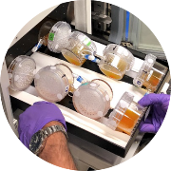
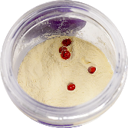
Space Synthetic Biology
View of BioNutrients-1 production packs during ISS crew operations. Packs were removed from incubator for mid-course agitation.
CO₂-Based Manufacturing project prototype that demonstrated the production of formic acid from CO₂ and water, while also producing oxygen.
Ground testing of BioNutrients-1 production packs in SABL flight incubator (ground unit) to verify temperature, fit and no leakage.
View of open BioNutrients-1 production pack during loading. Dried edible media (powder) and yeast pellets (red) are visible.
State-of-the-Art CO₂ electrochemical system that converts CO₂ and water to formic acid without electrolytes. The formic acid serves as an media for microbial production systems.
Loading BioNutrients-1 production packs with media and organisms under sterile conditions. The pack lid and sterile water filter are attached during this assembly.

